Slide 1
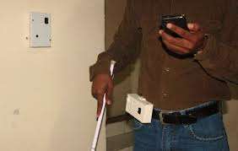
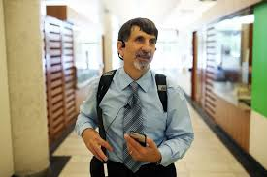
SMART NAVIGATION SYSTEM FOR THE VISUALLY IMPAIRED
Guides:
Dr.R. Rajavel, Associate Professor
Dr.S.Joseph Gladwin ,Associate Professor
Department Of ECE
SSN College Of Engineering
A Project by :
P.Sivasankar
S.Somasundar
K.Vimal Raj
V.Prakash
R.Ravishankar
M.Naveen Narayanan
3rd Year
SSN College Of Engineering

Slide 2
OUTLINE
The project proposes the following:
Creating a smart hand held device for the visually impaired to help them move around freely in the unknown environment ,with the help of voice messages
Designing a smart cane for obstacle detection ,by intimating the visually impaired via vibration.
3. Both the devices together forms the smart stand alone navigation system for the visually impaired people.

Slide 3
MOTIVATION
According to the WHO in 2014, 285 million people are estimated to be visually impaired worldwide: 39 million are blind and 246 million have low vision.
In India alone there are 6 million visually impaired people with over 30000 added every year according to a report by IndiaToday in 2015.
These large numbers are disheartening and help should be provided in some manner.
Navigation is required for the survival of all human beings.
Most places do not have any special amenities or facilities which help in the guiding of the visually challenged. This becomes a serious burden as their movements are restricted and they also require others help to move from one place to another.
Visually challenged people all over the world face difficulties in navigation, particularly in an unknown environment.
Most of them use normal cane to navigate for their regular activities.
Others use dog guides for their navigation.
They face challenge only when they want to navigate in a new environment, where they need help from others.
Hence there is a need for a system to guide them in such cases.

Slide 4
PROPOSED DESIGN
SMART HAND HELD DEVICE
This project is intended to develop a self-assistive in-door navigation system such as hospitals, schools etc… for visually impaired people through Wi-Fi.
The system makes use of wireless routers, placed at different locations in the building and all these routers will be connected to a common server through a switch.
The user will be provided with a wireless transceiver and whenever the user is near a Wi-Fi router, the device will get paired up and the corresponding MAC address of the router is sent to the server.
Thereby, the server can identify the connected router and the corresponding audio file, with the required direction information, is sent back to the intended device.
The received audio file could be played using a headphone connected to the transceiver through the audio jack.
When the user moves away from the Wi-Fi router, the transceiver will now get paired to the next Wi-Fi router and once again the required audio file will be provided by the server.

Slide 5
PROPOSED DESIGN
SMART CANE
The ultrasonic sensors will be placed on the white cane to detect the obstacles.
Along with the sensors , a microprocessor is also connected to the cane.
The sensors detect any obstacle and send the output to the microprocessor.
The microprocessor in turn is connected to the device and the server .
When the sensor senses an obstacle, a vibration is sent to the person, thereby helping them to move about safely.

Slide 6
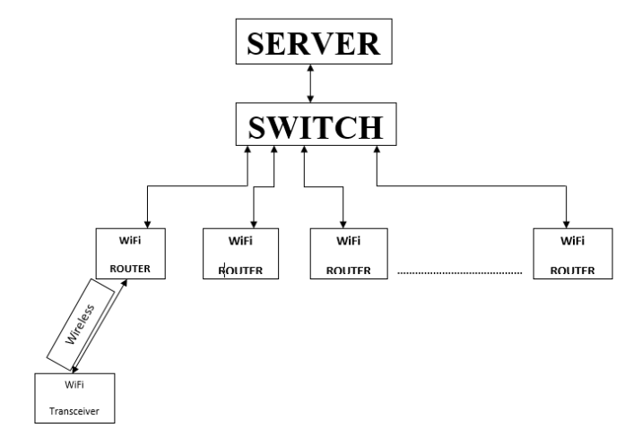
BLOCK DIAGRAM

Slide 7
OBJECTIVE
The objective of the project is
Setup a database server that stores the different audio files with direction guidelines to different places.
Place WI-Fi routers at different points and connect them to the server through a common switch.
Preconfigure the server with the MAC addresses of the router
Place the ultrasonic sensors along with the microcontroller on a cane to detect obstacles.

Slide 8
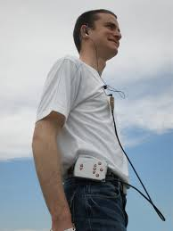
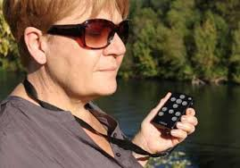
OUTCOMES:
The proposed solution will provide better safety measures for the visually impaired in navigation as shown in figure.
This will reduce their dependency on others also increase their confidence while navigating in unknown locations.

Slide 9
WORK PLAN
Methodology
1. First setting up a server that stores different audio files.
2. Connecting the router to the server.
3. When a mobile is connected to the Wi-Fi, the MAC address of the router is sent to the server.
4. Using the MAC address as an identity the required audio file with the direction is sent back to the mobile.
5. Replacing the mobile phone with a microcontroller (with Wi-Fi module) that has a 3.5mm audio jack.
6. Finally, expanding the system with many Wi-Fi routers and Wi-Fi transceivers.

Slide 10
FUTURE DIRECTIONS
After successful completion of the project, the developed smart standalone SLT system would help the visually challenged persons for indoor navigation without any hassles and reach the particular location safely by providing vocal assistance.
The above system can be extended for outdoor navigation using GPS.
Apart from the voice message regarding directions the system will also provide additional information about the facilities available in that location. Eg- If this system is implemented in a shopping mall then this system will be able to provide additional details about the shop such as the name of the shop, owner of the shop, offers in that shop etc.
The location of a person can also be traced from the server.
Most of the buildings have an inbuilt Wi-Fi system, so it would be easier to implement.

Slide 11
REFERENCES
Websites:
1. www.google.com
2. http://indiatoday.intoday.in/story/india-blind-newsflicks-eyes-bin/1/428125.html
3.http://www.who.int/mediacentre/factsheets/fs282/en/
There has already been a great deal of work done both in India and
abroad in the area of indoor navigation. Although the area of indoor navigation using Wi-Fi is less mature, there have been some recent breakthroughs. Here we list few ongoing researches in this field:
Papers:
1. The GuideCane-applying mobile robot technologies to assist the visually impaired
Author(s) I. Ulrich ; J. Borenstein a IEEE paper.
2. Application of WiFi-based Indoor Positioning System in Handheld Directory System
Author(s) LEE PIEH WEN, CHAN WEE NEE, KHOR MENG CHUN, TAN SHIANG-YEN, ROSNAH IDRUS, School of Computer Sciences, Universiti Sains Malaysia, MALAYSIA

Slide 12
CONCLUSION
There has been a raising demand to have a smart system that will aid visually impaired people to navigate and avoid obstacles in indoor environment. The aim of this project is to develop a marketable product that will bridge the impairment in communication between normal person and visually impaired people.
In today’s scenario, not much focus has been given on the indoor navigation for visually impaired, which is equally important as external navigation. This smart self-assistive navigation system will provide voice based guidance as an alternate to current conventional cane.
The proposed system can be implemented in large buildings such as malls, banks, hospitals, schools, offices and in other areas with inbuilt Wi-Fi system.

Slide 13
THANK YOU

